Slide 1
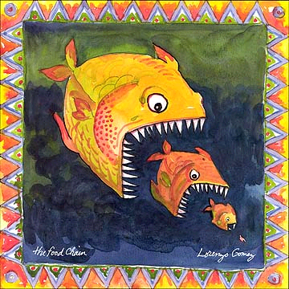
Energy Flow, Where Does it Go?
Brittany Hettrick and Jennifer White
Blue Springs School District

Slide 2
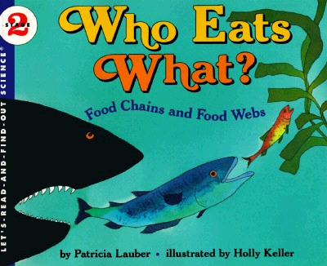
Engage:
Read Aloud

Slide 3
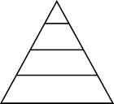
Explore
Interactive Activity- Energy Flow, Where Does it Go?
4. “Bears” collect 4 baggies
3. “Foxes” collect 3 baggies. 1 bag is discarded
2. “Rabbits” collect 2 baggies. I bag is discarded.
1. Macaroni in baggies for “Rabbits” to eat.

Slide 4
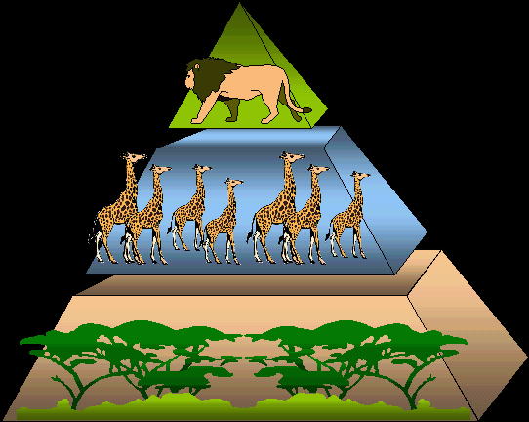
Explain:
Students will learn about the energy pyramid while constructing a vocabulary foldable.

Slide 5
Elaborate:

Slide 6
Evaluate:
GPS Activity

Slide 7
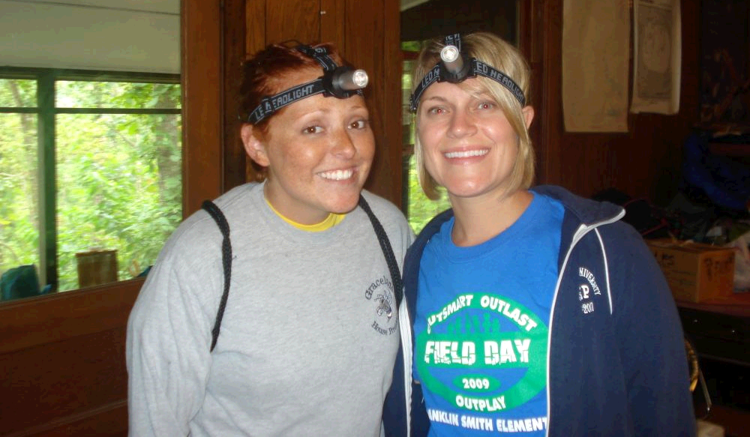
Additional Activities
Marine Food Chain Activity
Teacher and the Rockbots- Food Chain
BrainPOP- Food Chain Activity Sheet
Flow of Energy Group Paper (B.Hettrick and J.White)

